Slide 1
QSVM & QKMeans
Sachin Namdeo

Slide 2
Agenda
Quantum Support Vector Machine (QSVM)
Introduction to QSVM
Support Vector Machine (SVM) – Concept Refresher
QSVM Workflow
Kernel-Based QSVM – Basic Concepts
Hamiltonian-Based QSVM (Iris Dataset Case Study)
Classical vs Quantum QSVM – Comparison
QSVM Merits, Demerits & Future Prospects
Quantum K-Means (QKMeans)
Introduction to QKMeans
KMeans – Basic Concepts & Refresher
QKMeans Workflow
Classical vs Quantum KMeans – Comparison
QKMeans Merits, Demerits & Future Prospects

Slide 3
Quantum Support Vector Machines
Quantum Support Vector Machines (QSVMs) represent an innovative fusion of quantum computing and classical machine learning, designed to harness the computational advantages of quantum mechanics for complex classification tasks.
A key component of QSVMs is quantum kernel estimation, which maps data into complex quantum feature spaces.
This approach enables the model to identify intricate relationships within the data that might be missed by classical methods, enhancing classification performance, especially in high-dimensional scenarios.

Slide 4
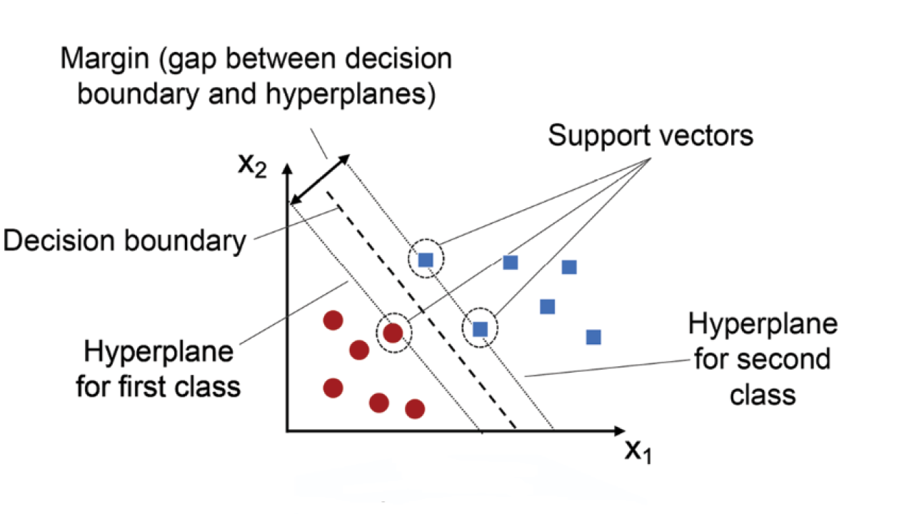
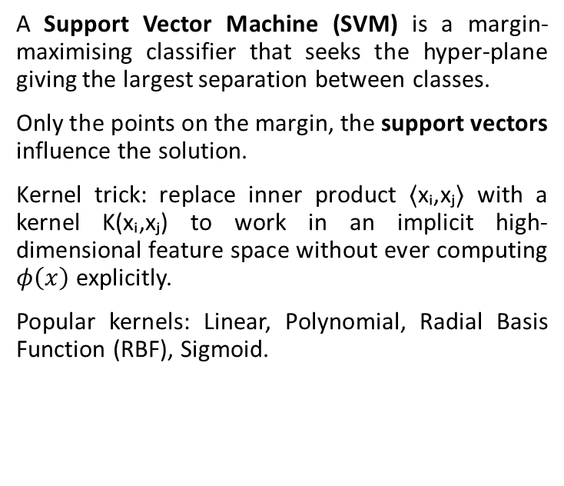
Support Vector Machine - Concept Refresher
A Support Vector Machine (SVM) is a margin-maximising classifier that seeks the hyper-plane giving the largest separation between classes.
Only the points on the margin, the support vectors influence the solution.
Kernel trick: replace inner product ⟨xᵢ,xⱼ⟩ with a kernel K(xᵢ,xⱼ) to work in an implicit high-dimensional feature space without ever computing $φ\left(x\right)$ explicitly.
Popular kernels: Linear, Polynomial, Radial Basis Function (RBF), Sigmoid.

Slide 5
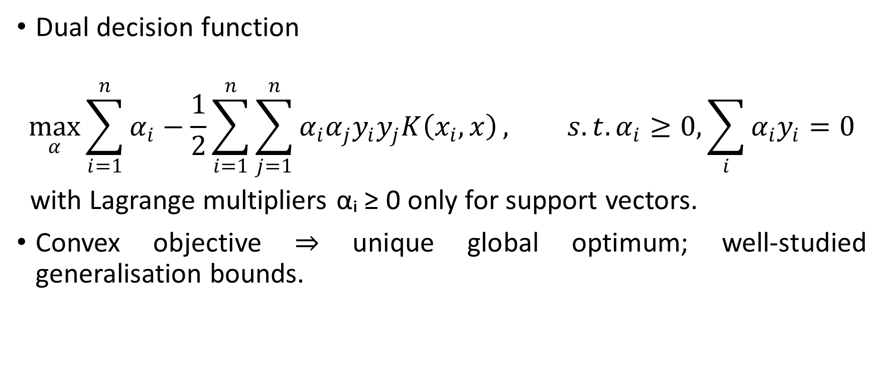
Support Vector Machine - Concept Refresher
Dual decision function
$$\max_{α}{\sum_{i=1}^{n}{α_{i}−\frac{1}{2}\sum_{i=1}^{n}{\sum_{j=1}^{n}{α_{i}α_{j}y_{i}y_{j}K\left(x_{i},x\right)}}}}, s.t. α_{i}≥0, \sum_{i}{α_{i}y_{i}=0}$$
with Lagrange multipliers αᵢ ≥ 0 only for support vectors.
Convex objective ⇒ unique global optimum; well-studied generalisation bounds.

Slide 6
Merits of Classical SVMs
Proven strong generalisation through margin maximisation.
Handles high-dimensional feature spaces gracefully via kernels.
Works well on small-to-medium, clean datasets, delivering state-of-the-art accuracy in many domains.
Flexible kernel choice lets practitioners model complex non-linear decision boundaries.

Slide 7
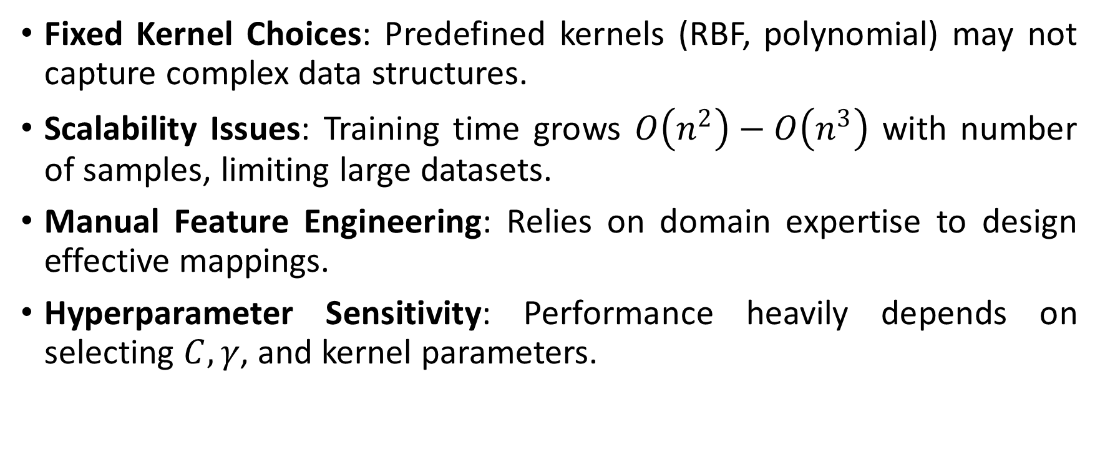
Demerits of Classical SVMs
Fixed Kernel Choices: Predefined kernels (RBF, polynomial) may not capture complex data structures.
Scalability Issues: Training time grows $O\left(n^{2}\right)−O\left(n^{3}\right)$ with number of samples, limiting large datasets.
Manual Feature Engineering: Relies on domain expertise to design effective mappings.
Hyperparameter Sensitivity: Performance heavily depends on selecting $C, γ$, and kernel parameters.

Slide 8
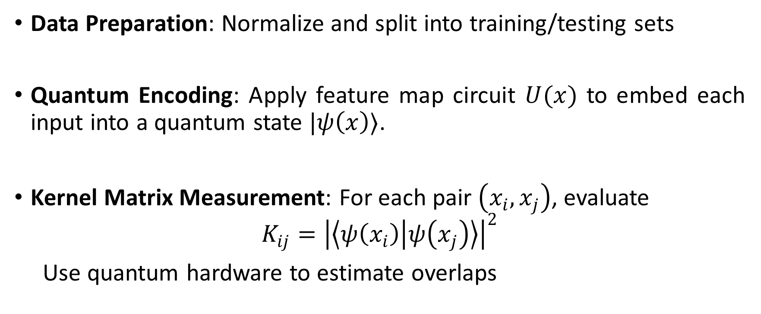
QSVM Workflow
Data Preparation: Normalize and split into training/testing sets
Quantum Encoding: Apply feature map circuit $U(x)$ to embed each input into a quantum state $|ψ\left(x\right)⟩$.
Kernel Matrix Measurement: For each pair $\left(x_{i},x_{j}\right)$, evaluate
$$K_{ij}={\left|\left\langle ψ\left(x_{i}\right) | ψ\left(x_{j}\right)\right\rangle \right|}^{2}$$
Use quantum hardware to estimate overlaps

Slide 9
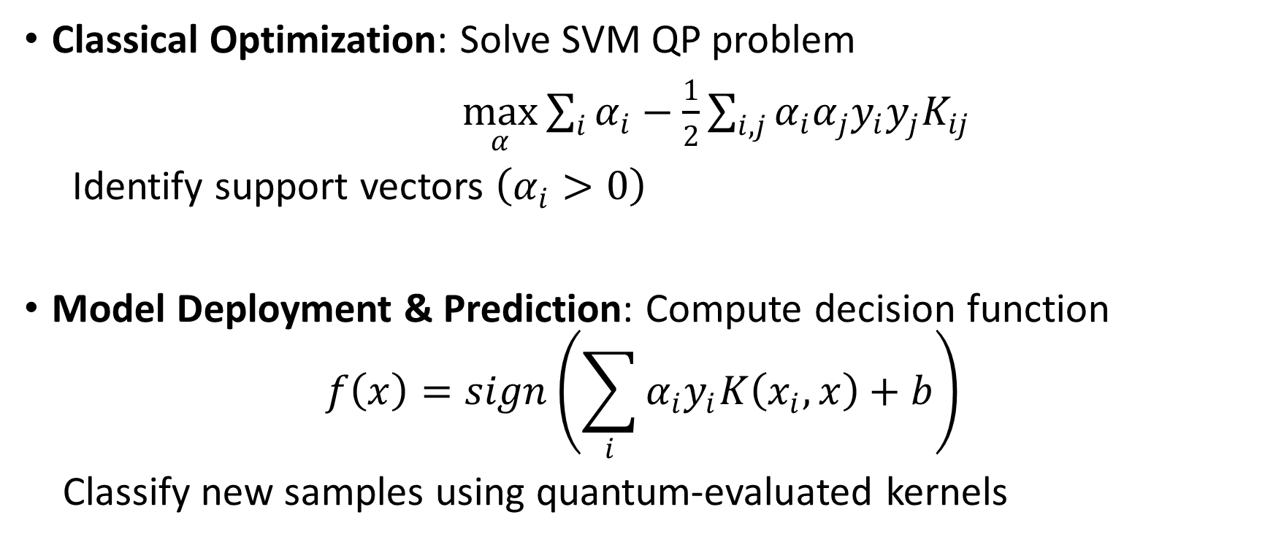
QSVM Workflow
Classical Optimization: Solve SVM QP problem
$\max_{α}{\sum_{i}{α_{i}−\frac{1}{2}\sum_{i,j}{α_{i}α_{j}y_{i}y_{j}K_{ij}}}}$​
Identify support vectors $\left(α_{i}>0\right)$
Model Deployment & Prediction: Compute decision function
$$f\left(x\right)=sign\left(\sum_{i}{α_{i}y_{i}K\left(x_{i},x\right)+b}\right)$$
Classify new samples using quantum-evaluated kernels

Slide 10
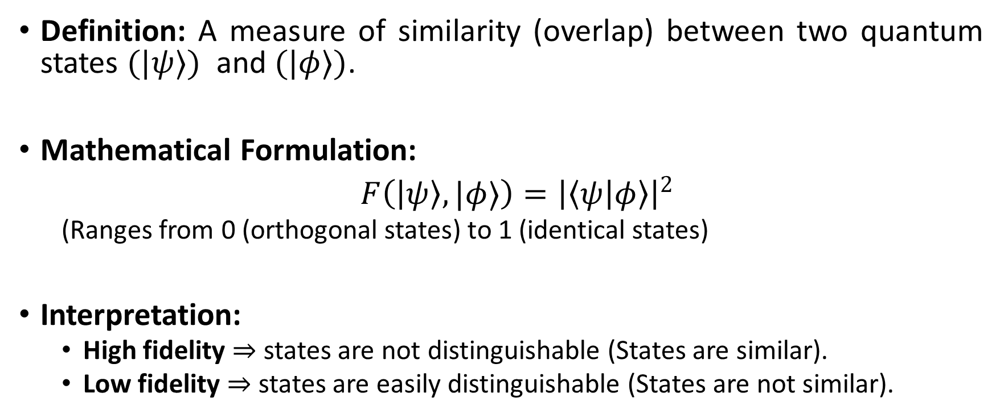
Fidelity
Definition: A measure of similarity (overlap) between two quantum states $(|ψ⟩)$ and $(|φ⟩)$.
Mathematical Formulation:
$F\left(\left|ψ\right\rangle , |φ⟩\right)={\left|\left\langle ψ | φ\right\rangle \right|}^{2}$
(Ranges from 0 (orthogonal states) to 1 (identical states)
Interpretation:
High fidelity ⇒ states are not distinguishable (States are similar).
Low fidelity ⇒ states are easily distinguishable (States are not similar).

Slide 11
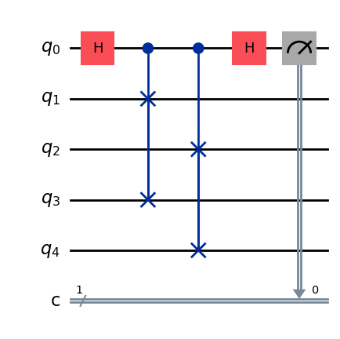
Measuring Fidelity using SWAP Test
Core Idea: Prepare copies of the states, entangle them with an ancilla via H–controlled-SWAP–H; ancilla outcome encodes their overlap (2P(0)−1).
Resource Cost: One ancilla qubit + two n-qubit data registers; overall circuit depth ≈ feature-map depth + 3 layers.
Typical Use-case: Exact fidelity of two pure states in small-qubit experiments.
Pros: Hardware-agnostic; conceptually simple; overlap obtained directly.
Cons: Requires preparation of both samples at the same time, doubling qubit needs; as the number of data qubits grows, the circuit gets deeper and harder to run.

Slide 12
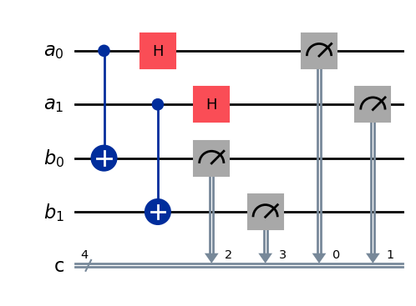
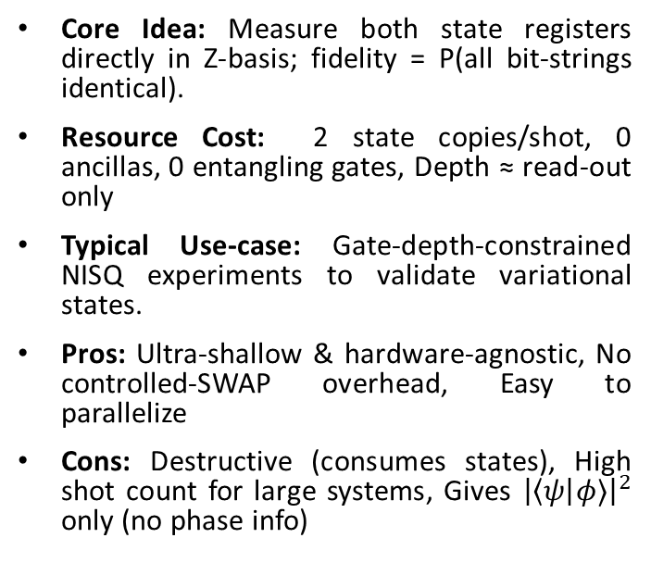
Destructive SWAP Test (Bit-string Comparison)
Core Idea: Measure both state registers directly in Z-basis; fidelity = P(all bit-strings identical).
Resource Cost: 2 state copies/shot, 0 ancillas, 0 entangling gates, Depth ≈ read-out only
Typical Use-case: Gate-depth-constrained NISQ experiments to validate variational states.
Pros: Ultra-shallow & hardware-agnostic, No controlled-SWAP overhead, Easy to parallelize
Cons: Destructive (consumes states), High shot count for large systems, Gives ${\left|\left\langle ψ\right|φ⟩\right|}^{2}$ only (no phase info)

Slide 13
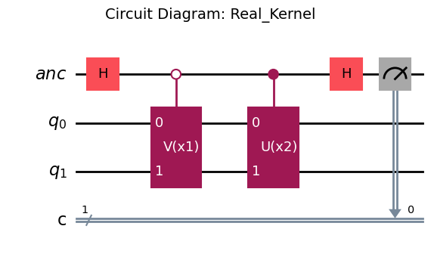
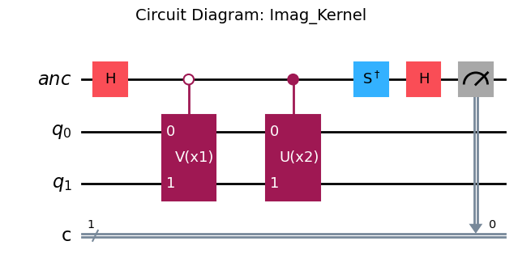
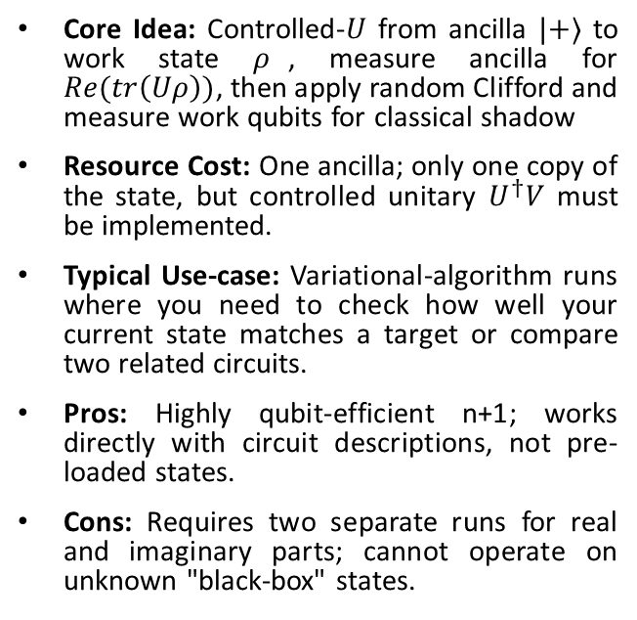
Measuring Fidelity using Hadamard / Inner-Product Test
Core Idea: Controlled-$U$ from ancilla $|+⟩$ to work state $ρ$, measure ancilla for $Re(tr\left(Uρ\right))$, then apply random Clifford and measure work qubits for classical shadow
Resource Cost: One ancilla; only one copy of the state, but controlled unitary $U^{†}V$ must be implemented.
Typical Use-case: Variational-algorithm runs where you need to check how well your current state matches a target or compare two related circuits.
Pros: Highly qubit-efficient n+1; works directly with circuit descriptions, not pre-loaded states.
Cons: Requires two separate runs for real and imaginary parts; cannot operate on unknown "black-box" states.

Slide 14
Types of Quantum Kernels
Fidelity-Based Quantum Kernels: Quantum state overlap as a similarity measure.
Entanglement-Enhanced Kernels: Using feature maps with entangled qubits to generate feature correlations.
Variational Quantum Kernels: Using parametrized quantum circuits as feature maps with trainable parameters to adapt the kernel to data.

Slide 15
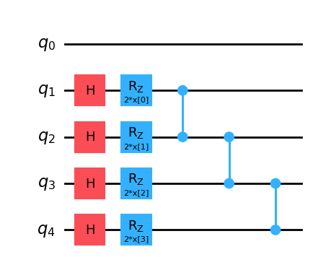
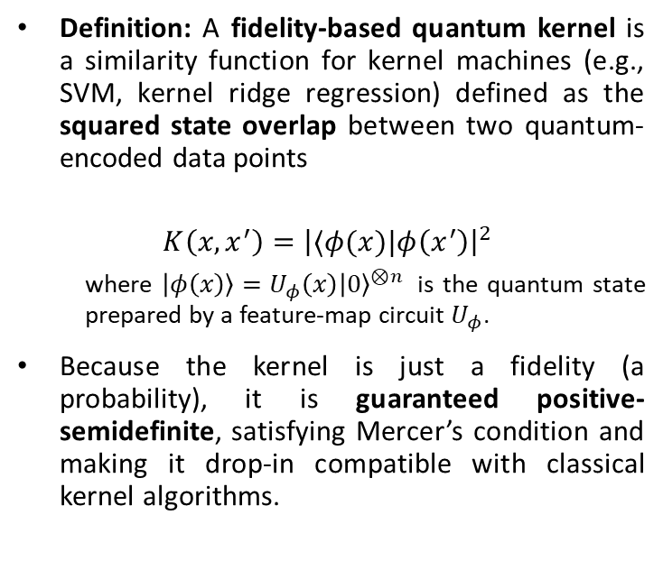
Fidelity Based Quantum Kernel
Definition: A fidelity-based quantum kernel is a similarity function for kernel machines (e.g., SVM, kernel ridge regression) defined as the squared state overlap between two quantum-encoded data points
$$K\left(x,x^{′}\right)={\left|⟨φ(x)|φ\left(x^{′}\right)\right|}^{2}$$
where $\left|φ\left(x\right)\right\rangle =U_{φ}\left(x\right){\left|0\right\rangle }^{⊗n }$ is the quantum state prepared by a feature-map circuit $U_{φ}$.
Because the kernel is just a fidelity (a probability), it is guaranteed positive-semidefinite, satisfying Mercer’s condition and making it drop-in compatible with classical kernel algorithms.

Slide 16
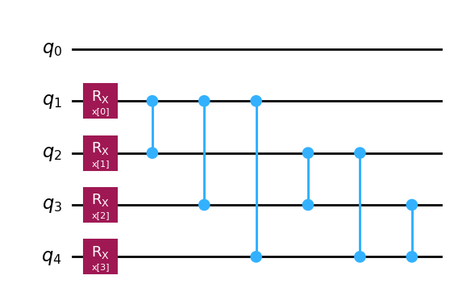
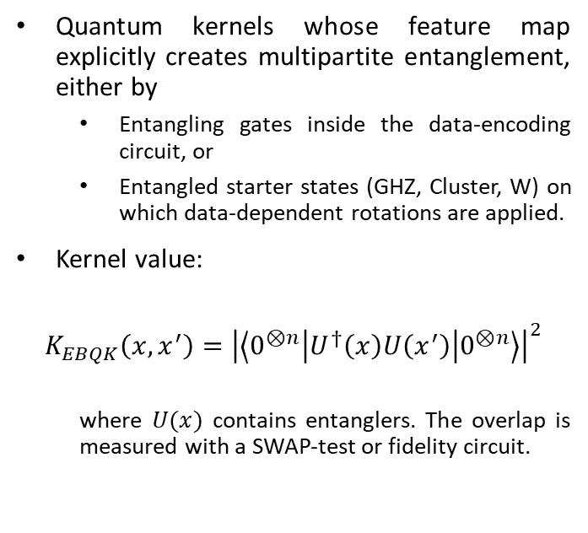
Entanglement Based Quantum Kernel
Quantum kernels whose feature map explicitly creates multipartite entanglement, either by
Entangling gates inside the data-encoding circuit, or
Entangled starter states (GHZ, Cluster, W) on which data-dependent rotations are applied.
Kernel value:
$$K_{EBQK}\left(x,x^{′}\right)={\left|\left\langle 0^{⊗n}\left|U^{†}\left(x\right)U\left(x^{′}\right)\right|0^{⊗n}\right\rangle \right|}^{2}$$
where $U(x)$ contains entanglers. The overlap is measured with a SWAP‐test or fidelity circuit.

Slide 17
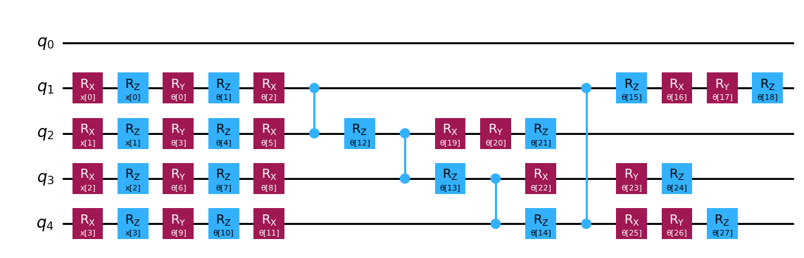
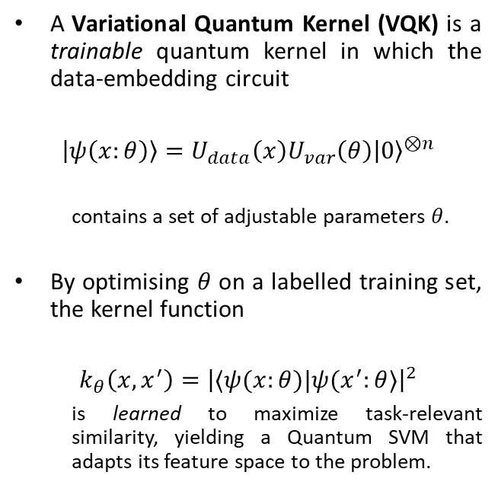
Variational Quantum Kernel
A Variational Quantum Kernel (VQK) is a trainable quantum kernel in which the data‐embedding circuit
$$\left|ψ\left(x:θ\right)\right\rangle =U_{data}\left(x\right)U_{var}\left(θ\right){\left|0\right\rangle }^{⊗n}$$
contains a set of adjustable parameters $θ$.
By optimising $θ$ on a labelled training set, the kernel function
$$k_{θ}\left(x,x^{′}\right)={\left|⟨ψ(x:θ)|ψ(x^{′}:θ⟩\right|}^{2}$$
is learned to maximize task-relevant similarity, yielding a Quantum SVM that adapts its feature space to the problem.

Slide 18
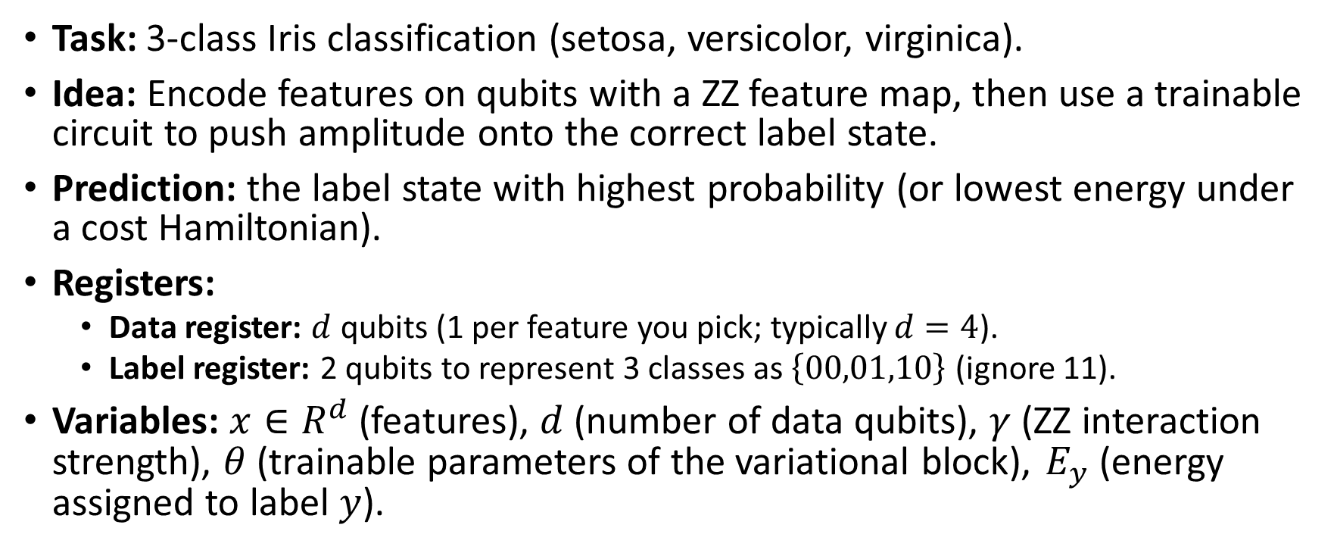
Hamiltonian Way To QSVM (Iris Dataset Example)
Task: 3-class Iris classification (setosa, versicolor, virginica).
Idea: Encode features on qubits with a ZZ feature map, then use a trainable circuit to push amplitude onto the correct label state.
Prediction: the label state with highest probability (or lowest energy under a cost Hamiltonian).
Registers:
Data register: $d$ qubits (1 per feature you pick; typically $d=4$).
Label register: 2 qubits to represent 3 classes as $\left\{00,01,10\right\}$ (ignore 11).
Variables: $x∈R^{d}$ (features), $d$ (number of data qubits), $γ$ (ZZ interaction strength), $θ$ (trainable parameters of the variational block), ​$E_{y}$ (energy assigned to label $y$).

Slide 19
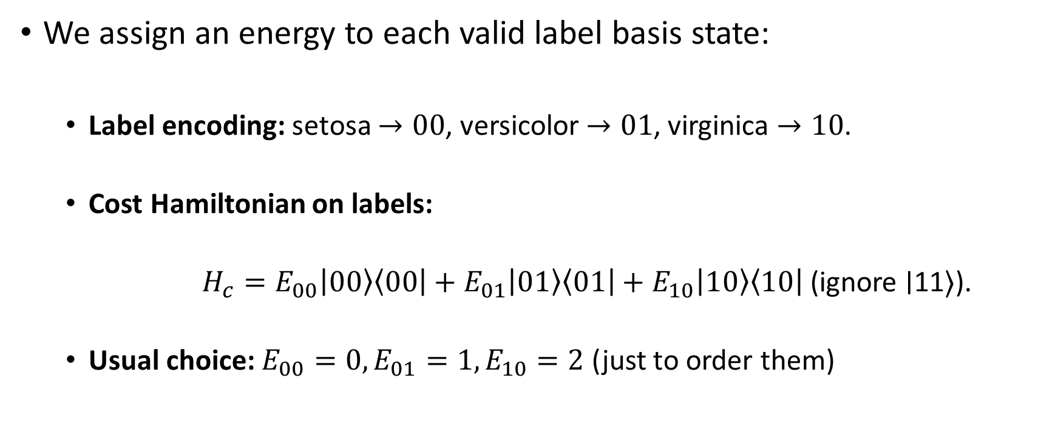
Cost Hamiltonian
We assign an energy to each valid label basis state:
Label encoding: setosa $→00$, versicolor $→01$, virginica $→10$.
Cost Hamiltonian on labels:
$H_{c}=E_{00}\left|00\right\rangle \left\langle 00\right|+E_{01}\left|01\right\rangle \left\langle 01\right|+E_{10}\left|10\right\rangle \left\langle 10\right|$ (ignore ∣11⟩).
Usual choice: $E_{00}=0, E_{01}=1, E_{10}=2$ (just to order them)

Slide 20
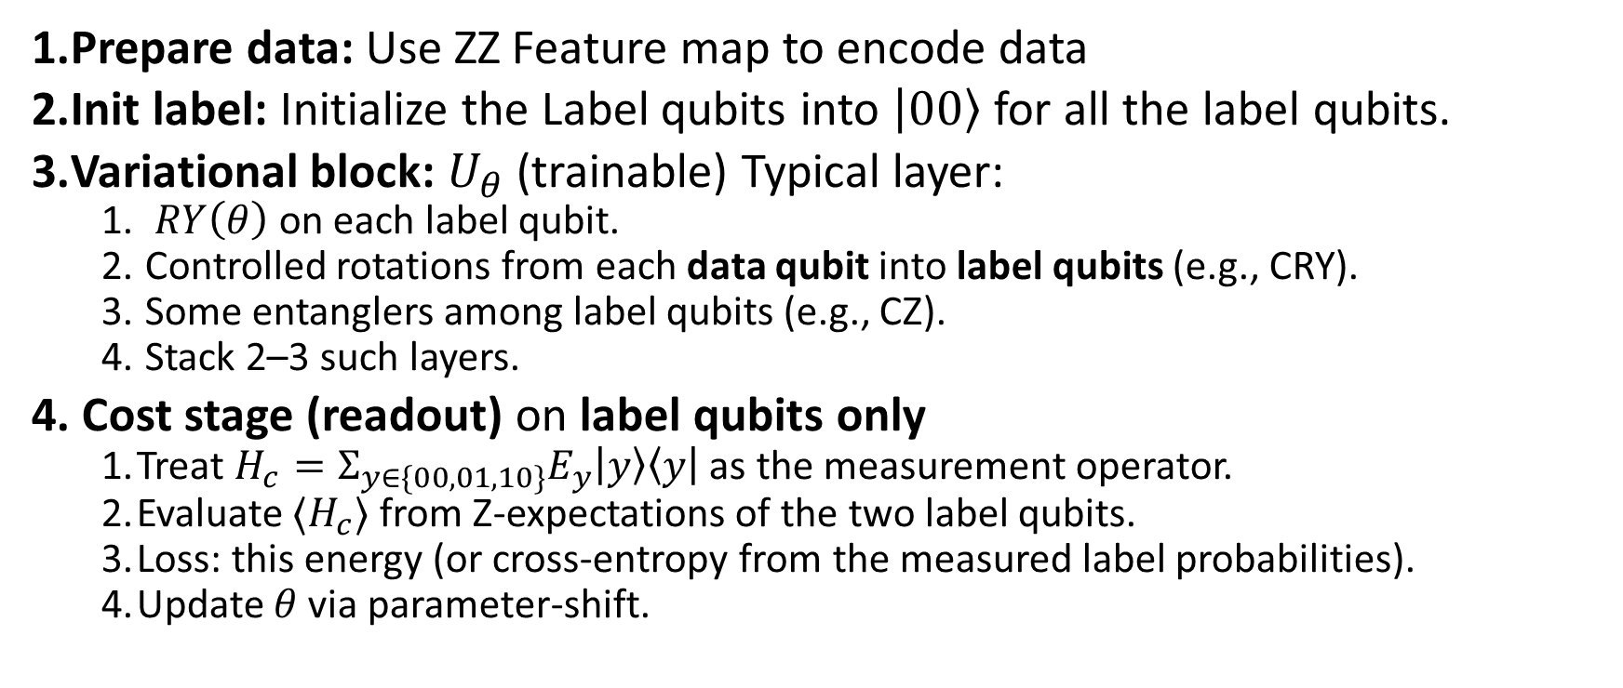
Full model circuit (data + label)
Prepare data: Use ZZ Feature map to encode data
Init label: Initialize the Label qubits into $\left|00\right\rangle$ for all the label qubits.
Variational block: $U_{θ}$ (trainable) Typical layer:
$RY\left(θ\right)$ on each label qubit.
Controlled rotations from each data qubit into label qubits (e.g., CRY).
Some entanglers among label qubits (e.g., CZ).
Stack 2–3 such layers.
Cost stage (readout) on label qubits only
Treat $H_{c}=Σ_{y∈\{00,01,10\}}E_{y}\left|y\right\rangle \left\langle y\right|$ as the measurement operator.
Evaluate $⟨H_{c}⟩$ from Z-expectations of the two label qubits.
Loss: this energy (or cross-entropy from the measured label probabilities).
Update $θ$ via parameter-shift.

Slide 21
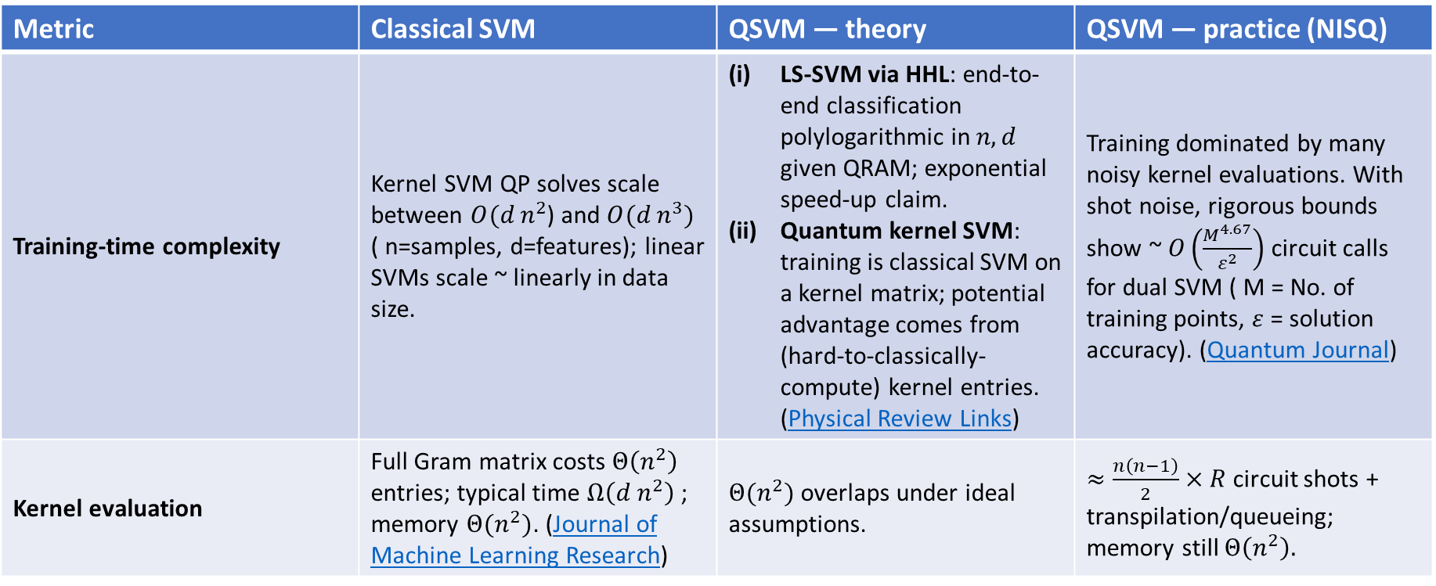
Comparison of Classical SVM vs QSVM
Metric | Classical SVM | QSVM — theory | QSVM — practice (NISQ)
Training-time complexity | Kernel SVM QP solves scale between $O(d n^{2}$) and $O(d n^{3})$ ( n=samples, d=features); linear SVMs scale ~ linearly in data size. | LS-SVM via HHL: end-to-end classification polylogarithmic in $n,d$ given QRAM; exponential speed-up claim. Quantum kernel SVM: training is classical SVM on a kernel matrix; potential advantage comes from (hard-to-classically-compute) kernel entries. (Physical Review Links) | Training dominated by many noisy kernel evaluations. With shot noise, rigorous bounds show ~ $O\left(\frac{M^{4.67}}{ε^{2}}\right)$ circuit calls for dual SVM ( M = No. of training points, $ε$ = solution accuracy). (Quantum Journal)
Kernel evaluation | Full Gram matrix costs $Θ\left(n^{2}\right)$ entries; typical time $Ω\left(d n^{2}\right)$; memory $Θ(n^{2})$. (Journal of Machine Learning Research) | $Θ(n^{2})$overlaps under ideal assumptions. | $≈\frac{n\left(n−1\right)}{2}×R$ circuit shots + transpilation/queueing; memory still $Θ\left(n^{2}\right).$

Slide 22
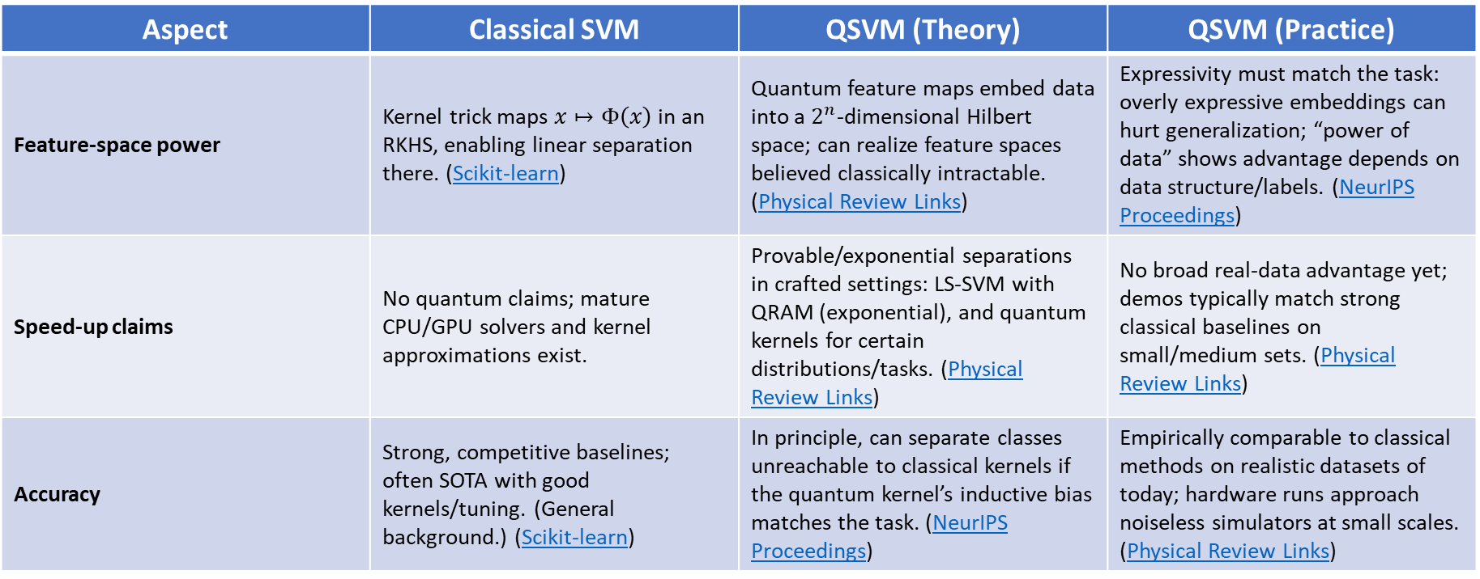
Comparison of Classical SVM vs QSVM
Aspect | Classical SVM | QSVM (Theory) | QSVM (Practice)
Feature-space power | Kernel trick maps $x↦Φ\left(x\right)$ in an RKHS, enabling linear separation there. (Scikit-learn) | Quantum feature maps embed data into a $2^{n}$-dimensional Hilbert space; can realize feature spaces believed classically intractable. (Physical Review Links) | Expressivity must match the task: overly expressive embeddings can hurt generalization; “power of data” shows advantage depends on data structure/labels. (NeurIPS Proceedings)
Speed-up claims | No quantum claims; mature CPU/GPU solvers and kernel approximations exist. | Provable/exponential separations in crafted settings: LS-SVM with QRAM (exponential), and quantum kernels for certain distributions/tasks. (Physical Review Links) | No broad real-data advantage yet; demos typically match strong classical baselines on small/medium sets. (Physical Review Links)
Accuracy | Strong, competitive baselines; often SOTA with good kernels/tuning. (General background.) (Scikit-learn) | In principle, can separate classes unreachable to classical kernels if the quantum kernel’s inductive bias matches the task. (NeurIPS Proceedings) | Empirically comparable to classical methods on realistic datasets of today; hardware runs approach noiseless simulators at small scales. (Physical Review Links)

Slide 23
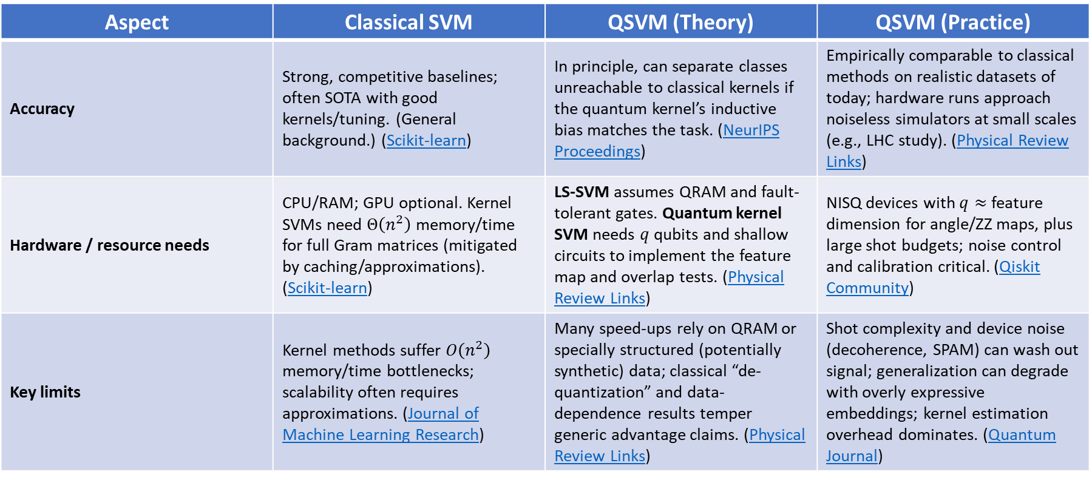
Comparison of Classical SVM vs QSVM
Aspect | Classical SVM | QSVM (Theory) | QSVM (Practice)
Accuracy | Strong, competitive baselines; often SOTA with good kernels/tuning. (General background.) (Scikit-learn) | In principle, can separate classes unreachable to classical kernels if the quantum kernel’s inductive bias matches the task. (NeurIPS Proceedings) | Empirically comparable to classical methods on realistic datasets of today; hardware runs approach noiseless simulators at small scales (e.g., LHC study). (Physical Review Links)
Hardware / resource needs | CPU/RAM; GPU optional. Kernel SVMs need $Θ\left(n^{2}\right)$ memory/time for full Gram matrices (mitigated by caching/approximations). (Scikit-learn) | LS-SVM assumes QRAM and fault-tolerant gates. Quantum kernel SVM needs $q$ qubits and shallow circuits to implement the feature map and overlap tests. (Physical Review Links) | NISQ devices with $q≈$ feature dimension for angle/ZZ maps, plus large shot budgets; noise control and calibration critical. (Qiskit Community)
Key limits | Kernel methods suffer $O\left(n^{2}\right)$ memory/time bottlenecks; scalability often requires approximations. (Journal of Machine Learning Research) | Many speed-ups rely on QRAM or specially structured (potentially synthetic) data; classical “de-quantization” and data-dependence results temper generic advantage claims. (Physical Review Links) | Shot complexity and device noise (decoherence, SPAM) can wash out signal; generalization can degrade with overly expressive embeddings; kernel estimation overhead dominates. (Quantum Journal)

Slide 24
Merits of Kernel method
Strong in small-N: Works very well on small to medium datasets (like Iris); little risk of underfitting.
Stable training: No circuit gradients; just build kernel matrix → classical SVM optimization is convex and reliable.
Simple modeling: Only tune SVM hyperparams (C, sometimes class weights); feature map stays fixed.
Support vectors: You get SVs and margins, nice interpretability and boundary diagnostics.
Shallow circuits: Overlap/ancilla tests can be shallow → more noise tolerant on NISQ.

Slide 25
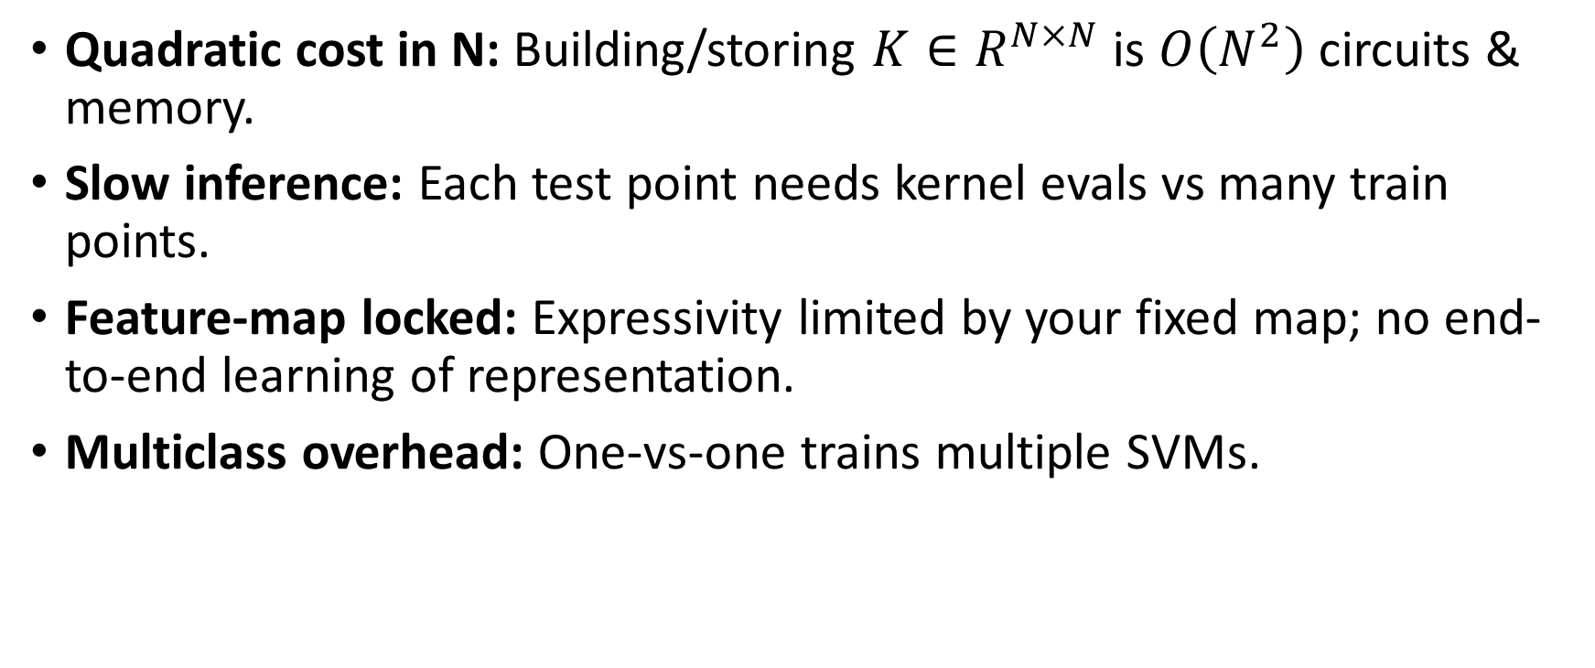
Demerits of Kernel method
Quadratic cost in N: Building/storing $K∈R^{N×N}$ is $O\left(N^{2}\right)$ circuits & memory.
Slow inference: Each test point needs kernel evals vs many train points.
Feature-map locked: Expressivity limited by your fixed map; no end-to-end learning of representation.
Multiclass overhead: One-vs-one trains multiple SVMs.

Slide 26
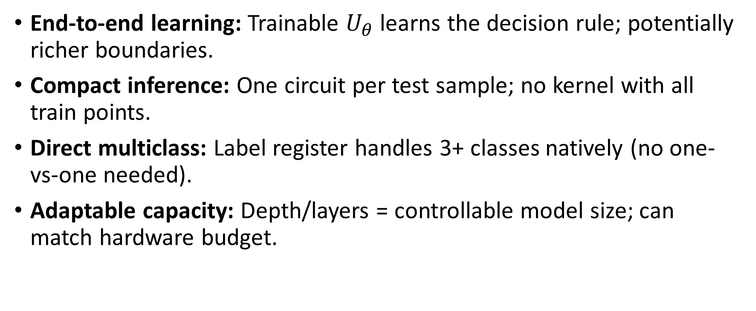
Merits of Hamiltonian method
End-to-end learning: Trainable $U_{θ}$​ learns the decision rule; potentially richer boundaries.
Compact inference: One circuit per test sample; no kernel with all train points.
Direct multiclass: Label register handles 3+ classes natively (no one-vs-one needed).
Adaptable capacity: Depth/layers = controllable model size; can match hardware budget.

Slide 27
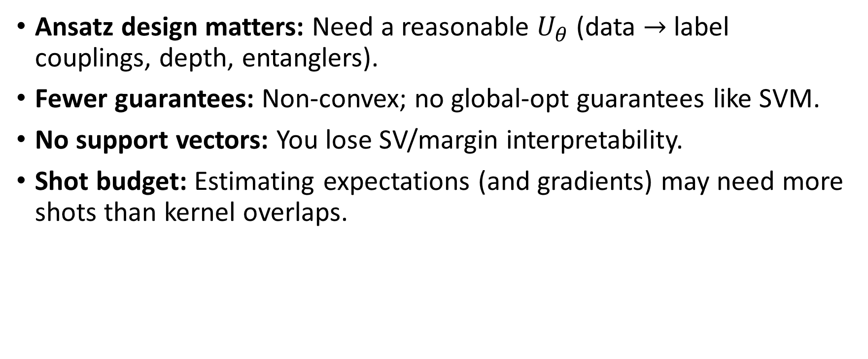
Demerits of Hamiltonian method
Ansatz design matters: Need a reasonable $U_{θ}$​ (data $→$ label couplings, depth, entanglers).
Fewer guarantees: Non-convex; no global-opt guarantees like SVM.
No support vectors: You lose SV/margin interpretability.
Shot budget: Estimating expectations (and gradients) may need more shots than kernel overlaps.

Slide 28
Future Prospects of QSVM
Noise-adapted kernels: Improve kernel fidelity by tailoring circuits to the specific noise profile of each quantum device.
Scalable kernel evaluation: feasible through quantum random feature methods and sparse feature maps that cut the computational cost of building the kernel matrix.
Fault-tolerant runs: support deeper circuits and reliable kernel estimates, opening the door to a provable quantum advantage on large data sets.
Auto-optimising stacks: automatically search for the best quantum feature map and support-vector hyperparameters without manual tuning.
R&D focus: adaptive feature maps, sparse kernels, large public benchmarks, explainable quantum kernels and stronger error-mitigation techniques.

Slide 29
Quantum K Means
Quantum KMeans (QKMeans) is a hybrid clustering algorithm that leverages quantum computing concepts alongside traditional clustering methods.
At its core, QKMeans utilizes quantum circuits to compute similarity measures between data points and centroids, which serves as an alternative means for distance evaluation compared to classical Euclidean metrics.
The primary goal of QKMeans is to exploit potential quantum speed-ups and enhanced feature mapping through quantum state representations while still incorporating well-known classical techniques for cluster updating, convergence checking, and evaluation.

Slide 30
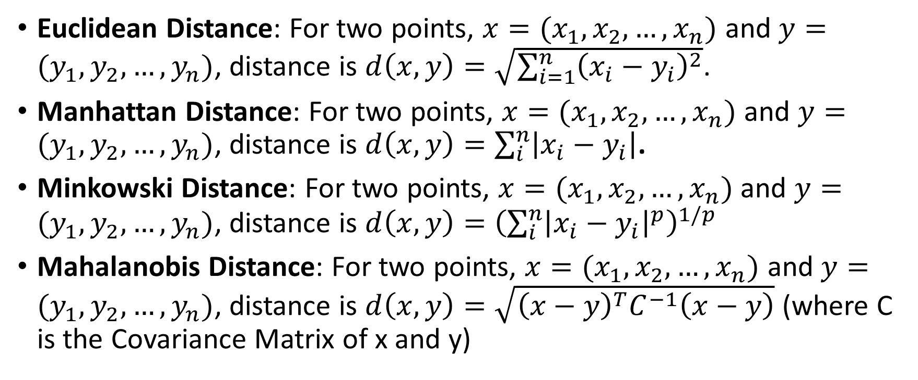
Distance Measurement for Classical K Means
Euclidean Distance: For two points, $x=(x_{1}, x_{2}, …, x_{n})$ and $y=(y_{1},y_{2},…, y_{n})$, distance is $d\left(x,y\right)=\sqrt{\sum_{i=1}^{n}{{\left(x_{i}−y_{i}\right)}^{2}}}$.
Manhattan Distance: For two points, $x=(x_{1}, x_{2}, …, x_{n})$ and $y=(y_{1},y_{2},…, y_{n})$, distance is $d\left(x,y\right)=\sum_{i}^{n}{\left|x_{i}−y_{i}\right|}$.
Minkowski Distance: For two points, $x=(x_{1}, x_{2}, …, x_{n})$ and $y=(y_{1},y_{2},…, y_{n})$, distance is $d\left(x,y\right)={\left(\sum_{i}^{n}{{\left|x_{i}−y_{i}\right|}^{p}}\right)}^{1/p}$
Mahalanobis Distance: For two points, $x=(x_{1}, x_{2}, …, x_{n})$ and $y=(y_{1},y_{2},…, y_{n})$, distance is $d\left(x,y\right)=\sqrt{{\left(x−y\right)}^{T}C^{−1}\left(x−y\right)}$ (where C is the Covariance Matrix of x and y)

Slide 31
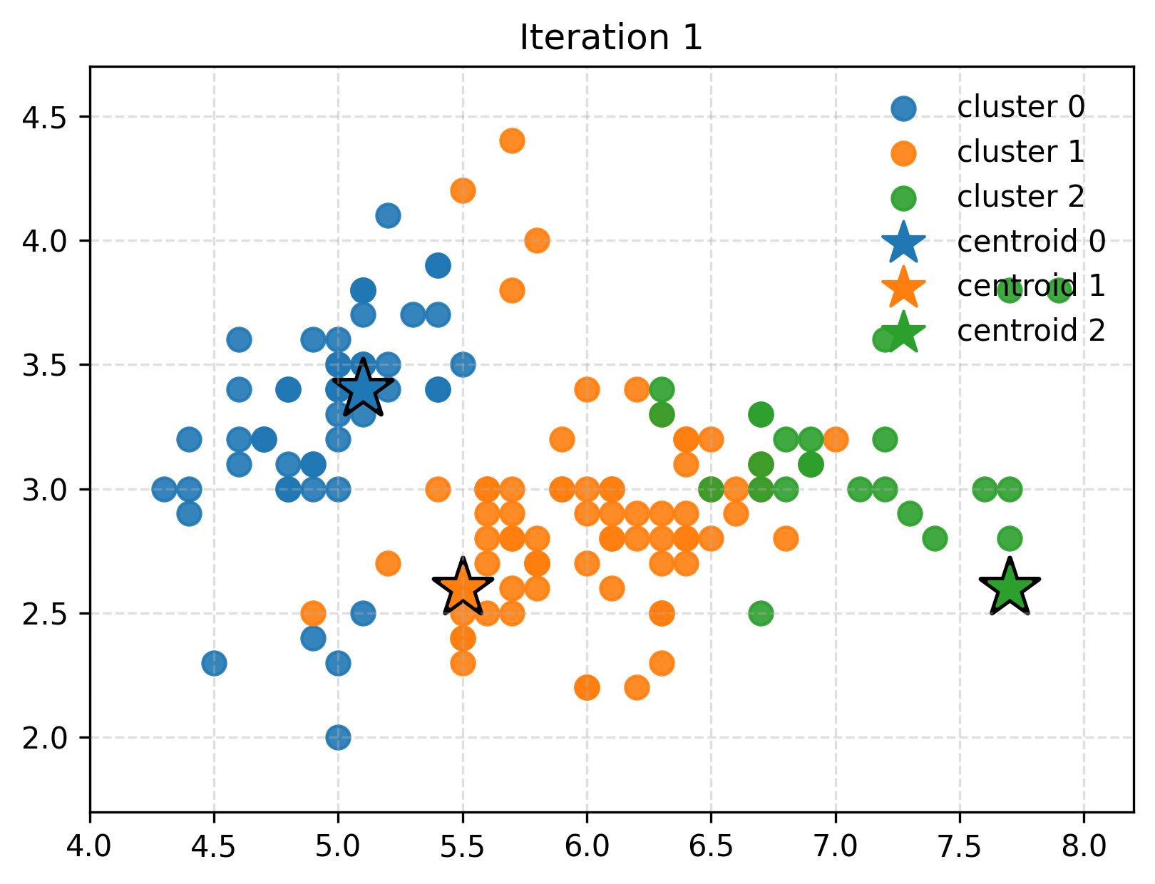
K Means Refresher
A K-Means clustering algorithm partitions n data points into k clusters by minimizing the within-cluster variance.
Classical K-Means is also known as Llyod’s K-Means because it was first proposed by Stuart Lloyd of Bell Labs in 1957.
It alternates between assignment (each point → nearest centroid) and update (centroid = mean of assigned points), so only those assignments influence the solution.
Initialization trick: k-means++ (smarter seed selection) or random seeding to improve convergence.
Distance metric: typically Euclidean.
Popular variants: K-Means++, Mini-Batch K-Means (for large-scale data).

Slide 32
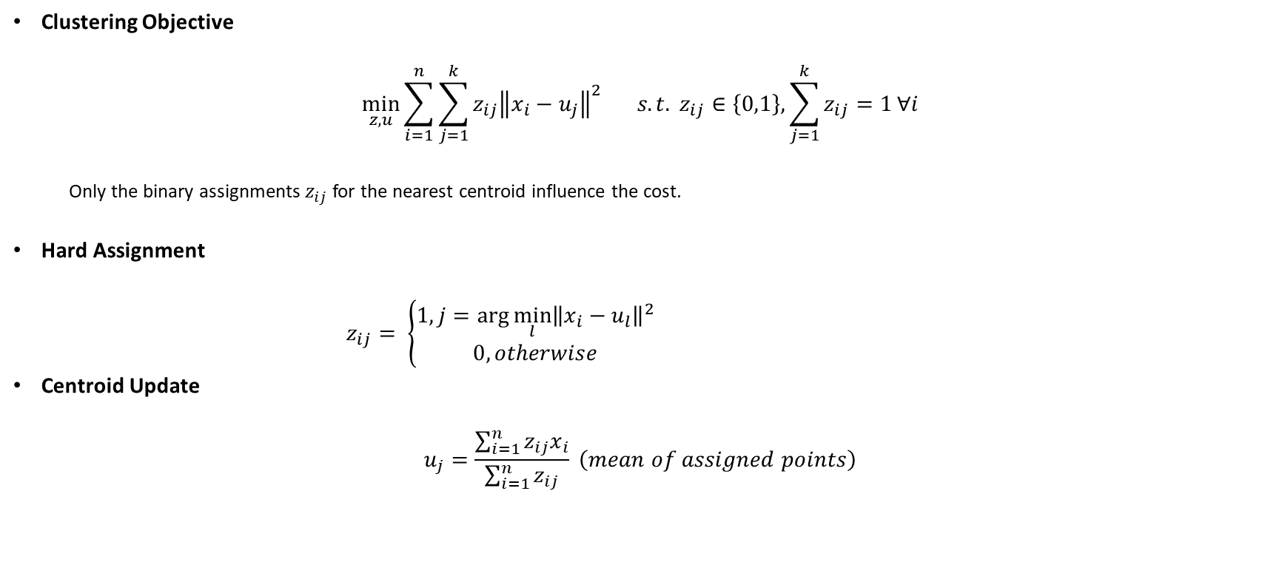
K Means Refresher
Clustering Objective
$$\min_{z,u}{\sum_{i=1}^{n}{\sum_{j=1}^{k}{z_{ij}{\left\|x_{i}−u_{j}\right\|}^{2}}}} s.t. z_{ij}∈\left\{0,1\right\}, \sum_{j=1}^{k}{z_{ij}=1}∀i$$
Only the binary assignments $z_{ij}$ for the nearest centroid influence the cost.
Hard Assignment
$z_{ij}= \left\{\begin{aligned}1, j=\arg{{\min_{l}\left\|x_{i}−u_{l}\right\|}^{2}} \\ 0, otherwise\end{aligned}\right.$
Centroid Update
$$u_{j}=\frac{\sum_{i=1}^{n}{z_{ij}x_{i}}}{\sum_{i=1}^{n}{z_{ij}}} \left(mean of assigned points\right)$$

Slide 33
Merits of K-Means
Simplicity
Scalability
Speed
Interpretable Centroids
Flexibility
Deterministic Refinement
Memory Efficiency

Slide 34
Demerits of K-Means
Requires Pre-specified k
Sensitive to Initialization
Converges to Local Minima
Outlier and Noise Sensitivity
Not Suitable for Categorical Data
Equal Cluster Size Bias
Distance Metric Dependence

Slide 35
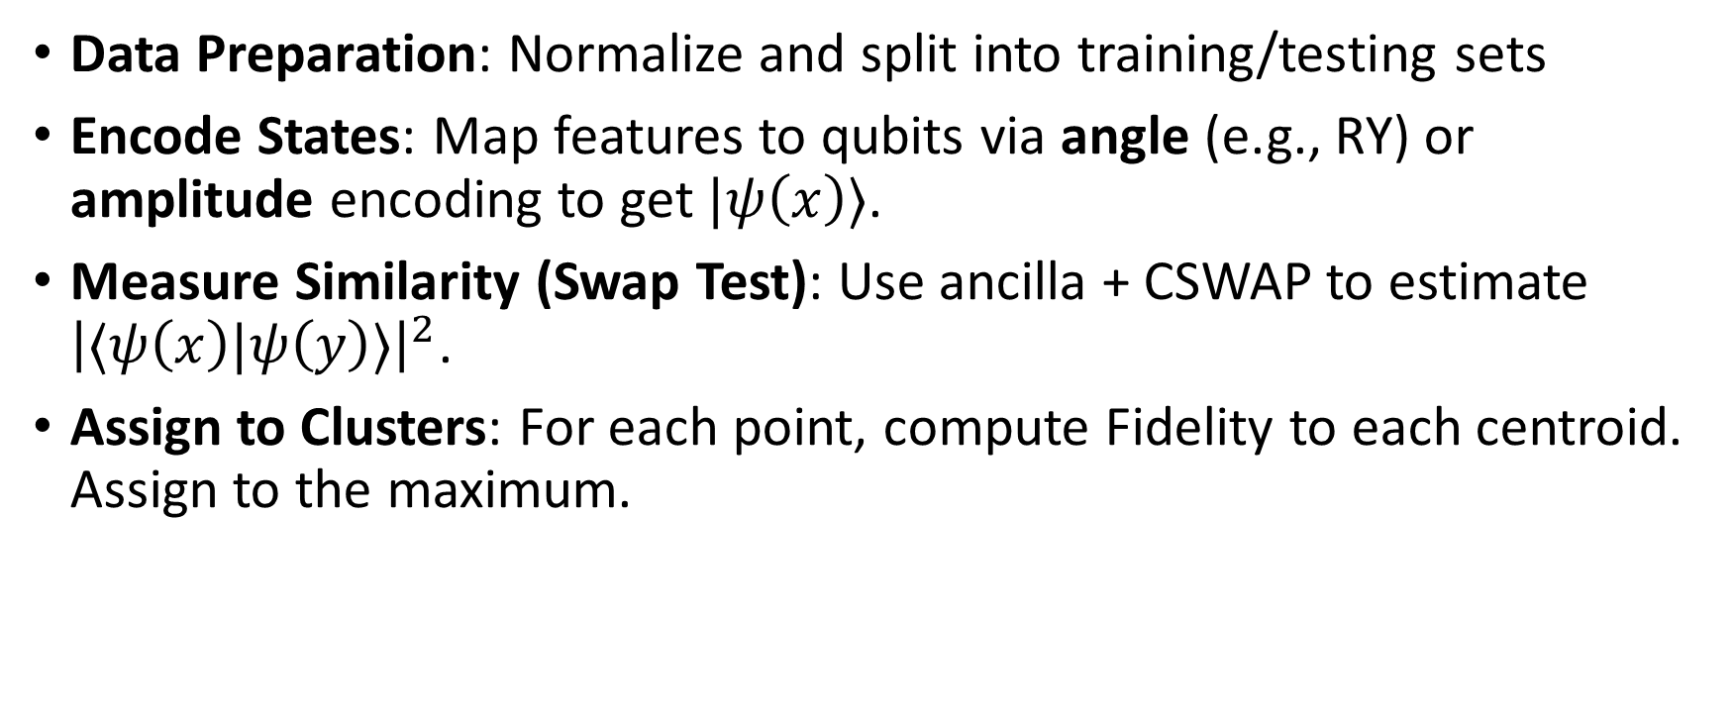
Quantum KMeans Workflow
Data Preparation: Normalize and split into training/testing sets
Encode States: Map features to qubits via angle (e.g., RY) or amplitude encoding to get $|ψ\left(x\right)⟩$.
Measure Similarity (Swap Test): Use ancilla + CSWAP to estimate ${\left|⟨ψ\left(x\right)|ψ\left(y\right)⟩\right|}^{2}$.
Assign to Clusters: For each point, compute Fidelity to each centroid. Assign to the maximum.

Slide 36
Quantum KMeans Workflow
Update Centroids (Classical): Recompute cluster means. No quantum needed here.
Iterate to Converge: Repeat assign and update until centroid shift < ε or max iterations hit; log history if needed.
Evaluate
Internal: Silhouette, Davies–Bouldin, Calinski–Harabasz.
External (if True labels available): ARI, NMI.

Slide 37
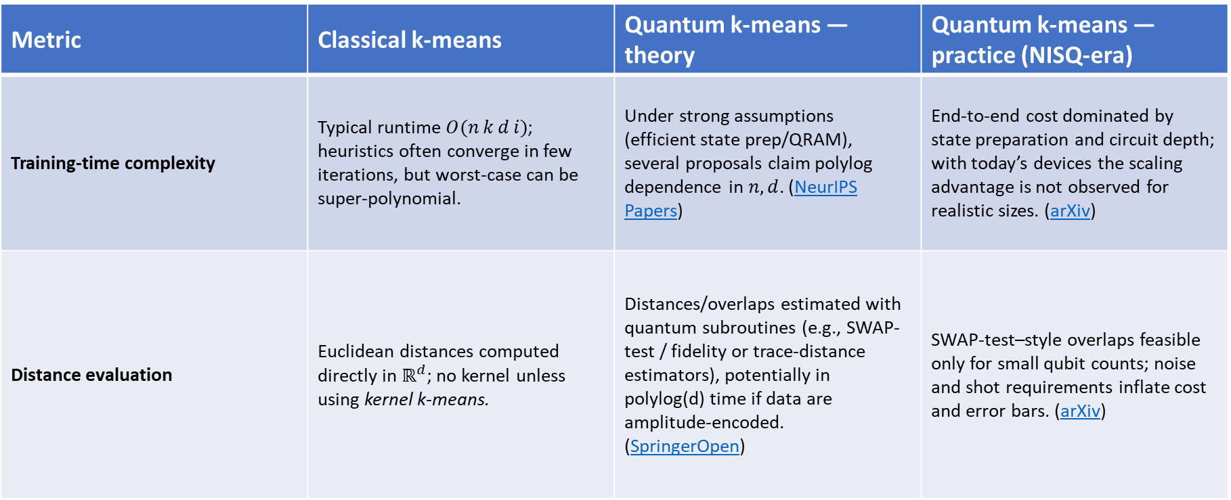
Comparison of Classical KMeans vs QKMeans
Metric | Classical k-means | Quantum k-means — theory | Quantum k-means — practice (NISQ-era)
Training-time complexity | Typical runtime $O(n k d i)$; heuristics often converge in few iterations, but worst-case can be super-polynomial. | Under strong assumptions (efficient state prep/QRAM), several proposals claim polylog dependence in $n,d$. (NeurIPS Papers) | End-to-end cost dominated by state preparation and circuit depth; with today’s devices the scaling advantage is not observed for realistic sizes. (arXiv)
Distance evaluation | Euclidean distances computed directly in $ℝ^{d}$; no kernel unless using kernel k-means. | Distances/overlaps estimated with quantum subroutines (e.g., SWAP-test / fidelity or trace-distance estimators), potentially in polylog(d) time if data are amplitude-encoded. (SpringerOpen) | SWAP-test–style overlaps feasible only for small qubit counts; noise and shot requirements inflate cost and error bars. (arXiv)

Slide 38
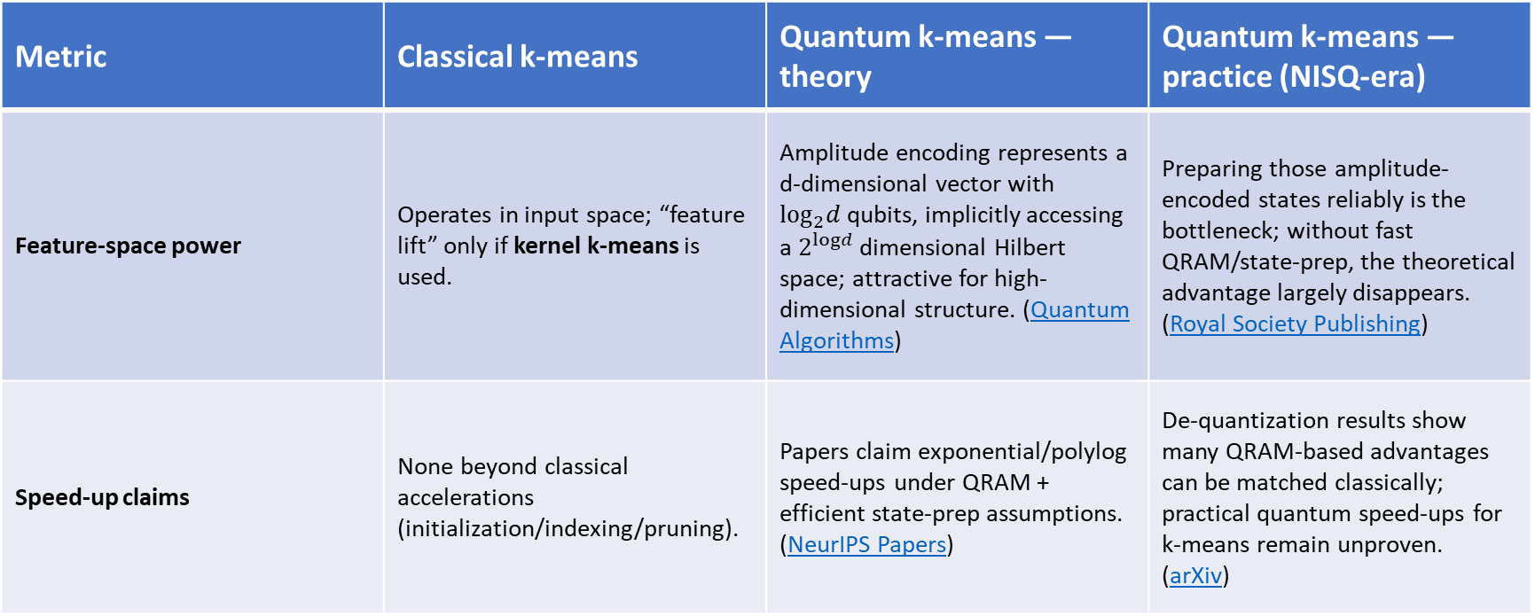
Comparison of Classical KMeans vs QKMeans
Metric | Classical k-means | Quantum k-means — theory | Quantum k-means — practice (NISQ-era)
Feature-space power | Operates in input space; “feature lift” only if kernel k-means is used. | Amplitude encoding represents a d-dimensional vector with $\log_{2}d$qubits, implicitly accessing a $2^{logd}$ dimensional Hilbert space; attractive for high-dimensional structure. (Quantum Algorithms) | Preparing those amplitude-encoded states reliably is the bottleneck; without fast QRAM/state-prep, the theoretical advantage largely disappears. (Royal Society Publishing)
Speed-up claims | None beyond classical accelerations (initialization/indexing/pruning). | Papers claim exponential/polylog speed-ups under QRAM + efficient state-prep assumptions. (NeurIPS Papers) | De-quantization results show many QRAM-based advantages can be matched classically; practical quantum speed-ups for k-means remain unproven. (arXiv)

Slide 39
Comparison of Classical KMeans vs QKMeans
Metric | Classical k-means | Quantum k-means — theory | Quantum k-means — practice (NISQ-era)
Accuracy | Strong baselines; accuracy determined by data shape, k, init (k-means++), etc. | In the idealized model, matches a robust k-means objective with similar precision guarantees. (NeurIPS Papers) | Small-scale studies on real/noisy hardware report comparable accuracy on toy datasets, with noise/circuit depth limiting performance. (arXiv)
Hardware / resource needs | CPU/GPU; scales to millions of points with optimized libs. | Fault-tolerant QC + QRAM for fast data access; assumes efficient, low-error amplitude encoding. (Physical Review Links) | NISQ devices (tens–hundreds of qubits) + simulators; no practical QRAM; depth/width and error rates are the main constraints. (arXiv)
Key limits | Sensitive to spherical-cluster assumption, local minima, choice of k. | Assumes fast data loading/QRAM and low-noise circuits, assumptions debated in feasibility and overall end-to-end cost. (Physical Review Links) | State-prep overhead overwhelms; noise/shot complexity; de-quantization weakens headline advantages on classical data. (Royal Society Publishing)

Slide 40
Merits of QKMeans
Potential poly log-in-N speed (with QRAM) vs. 𝑂(𝑘𝑁𝑑).
Expressive quantum features (overlaps/fidelity) for non-linear clusters.
Native similarity via compute-uncompute / SWAP circuits.
Hybrid-friendly: quantum embedding + classical assignment/update.

Slide 41

Demerits of QKMeans
QRAM/state-prep needed for theory wins; not practical yet.
Shot noise & device errors → many repetitions, unstable kernels.
Still $O\left(N^{2}\right)$ pairwise overlaps for assignments.
Encoding overhead: angle-enc needs $\sim d$ qubits; amplitude-enc costly.

Slide 42
Future prospects of QKMeans
Scalable, noise-tolerant QRAM architectures.
Lower-depth / multi-overlap estimators to cut kernel time.
Fault-tolerant hardware → deeper, richer feature maps.
Smarter hybrids: mini-batch qk-means, cached states.
Task targeting where quantum embeddings match data structure.

